Slide 1




UNIT: 2
PEEL Analysis

Slide 2



Put these in correct order (1 minute):
a linking sentence
a relevant quote
a clear opinion
a strong explanation

Slide 3
Put these in correct order (1 minute): Answer
a relevant quote
2
a linking sentence
4
a clear opinion
1
a strong explanation
3

Slide 4
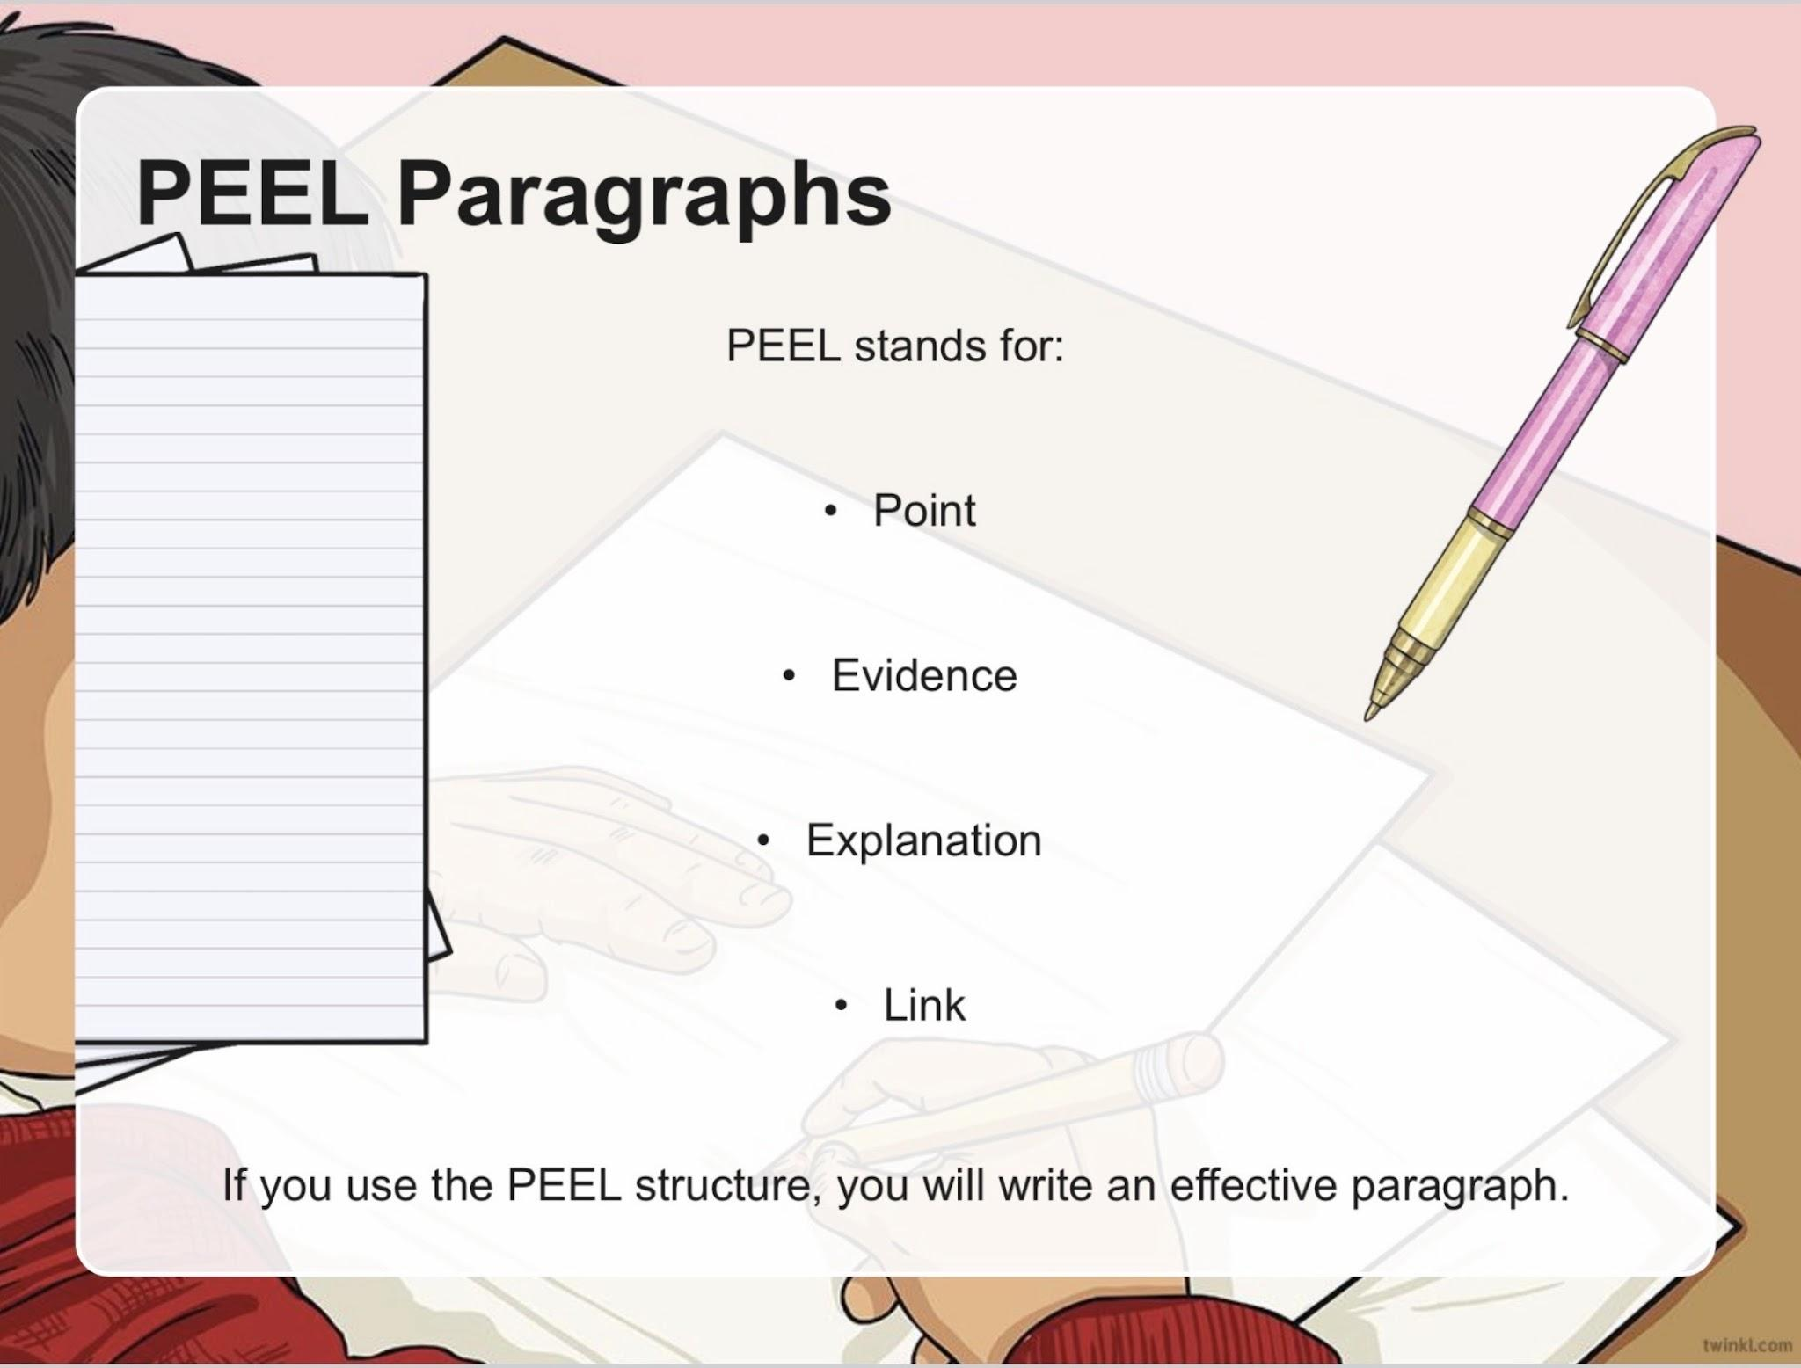

Slide 5
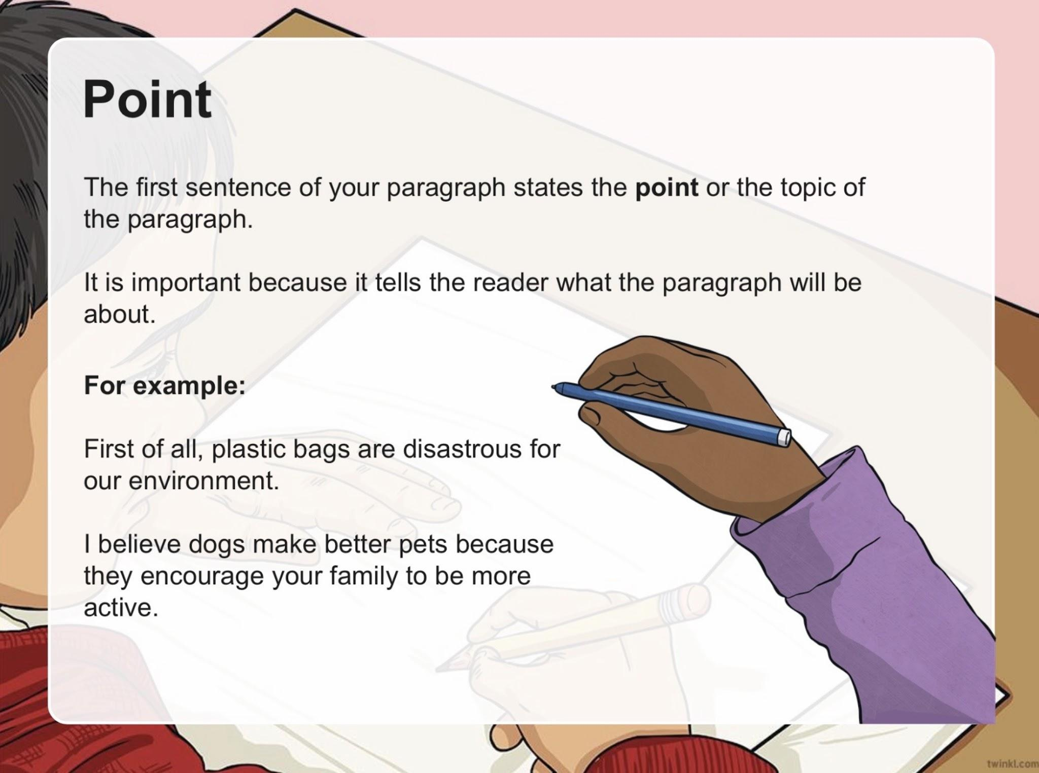

Slide 6
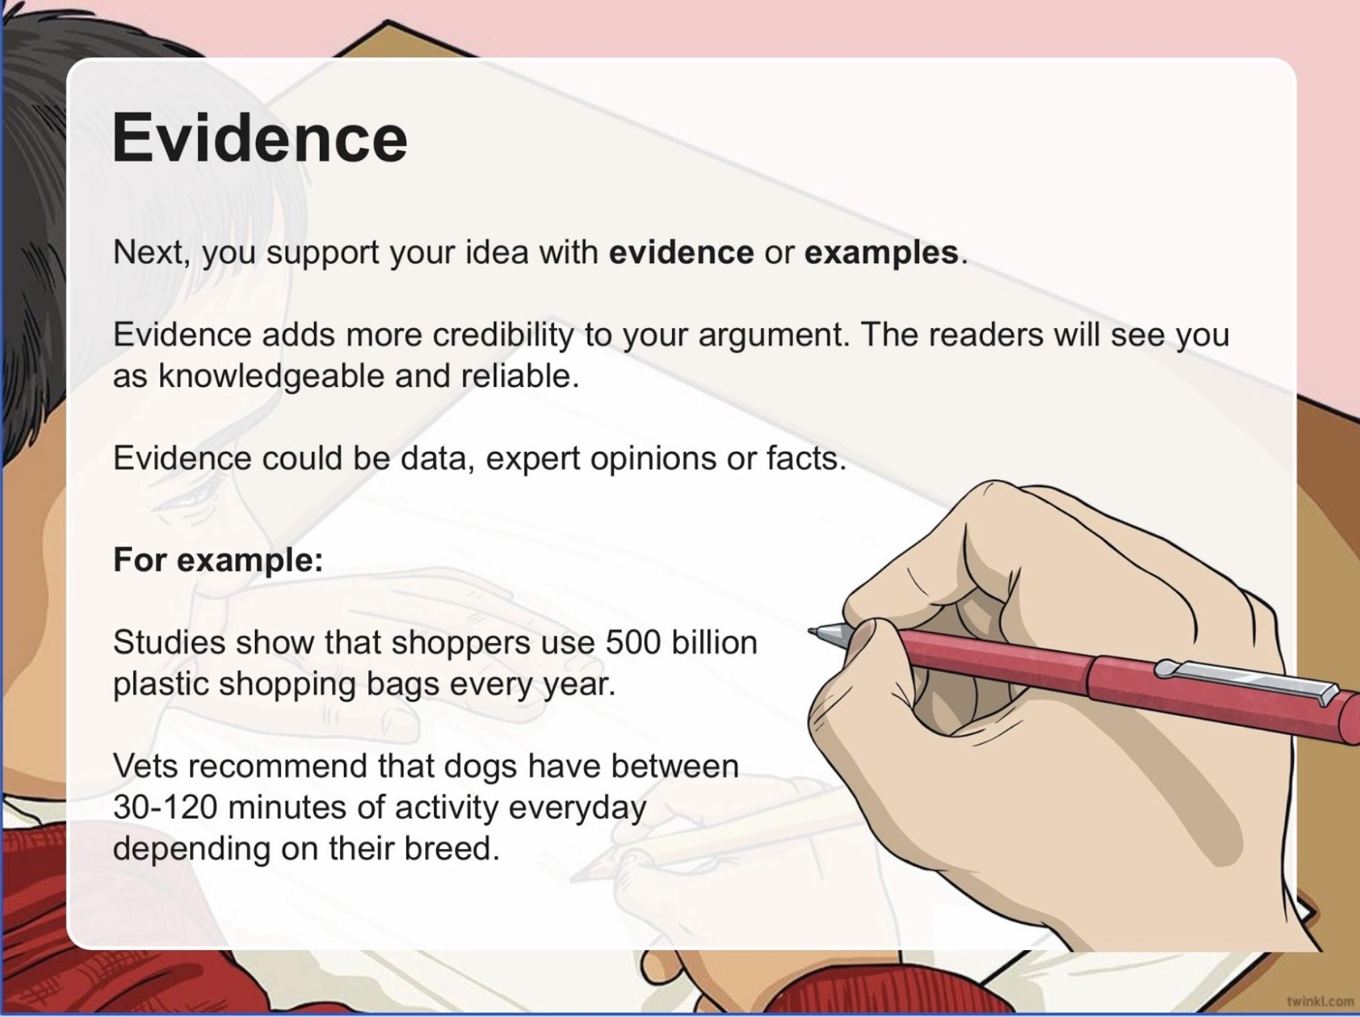

Slide 7
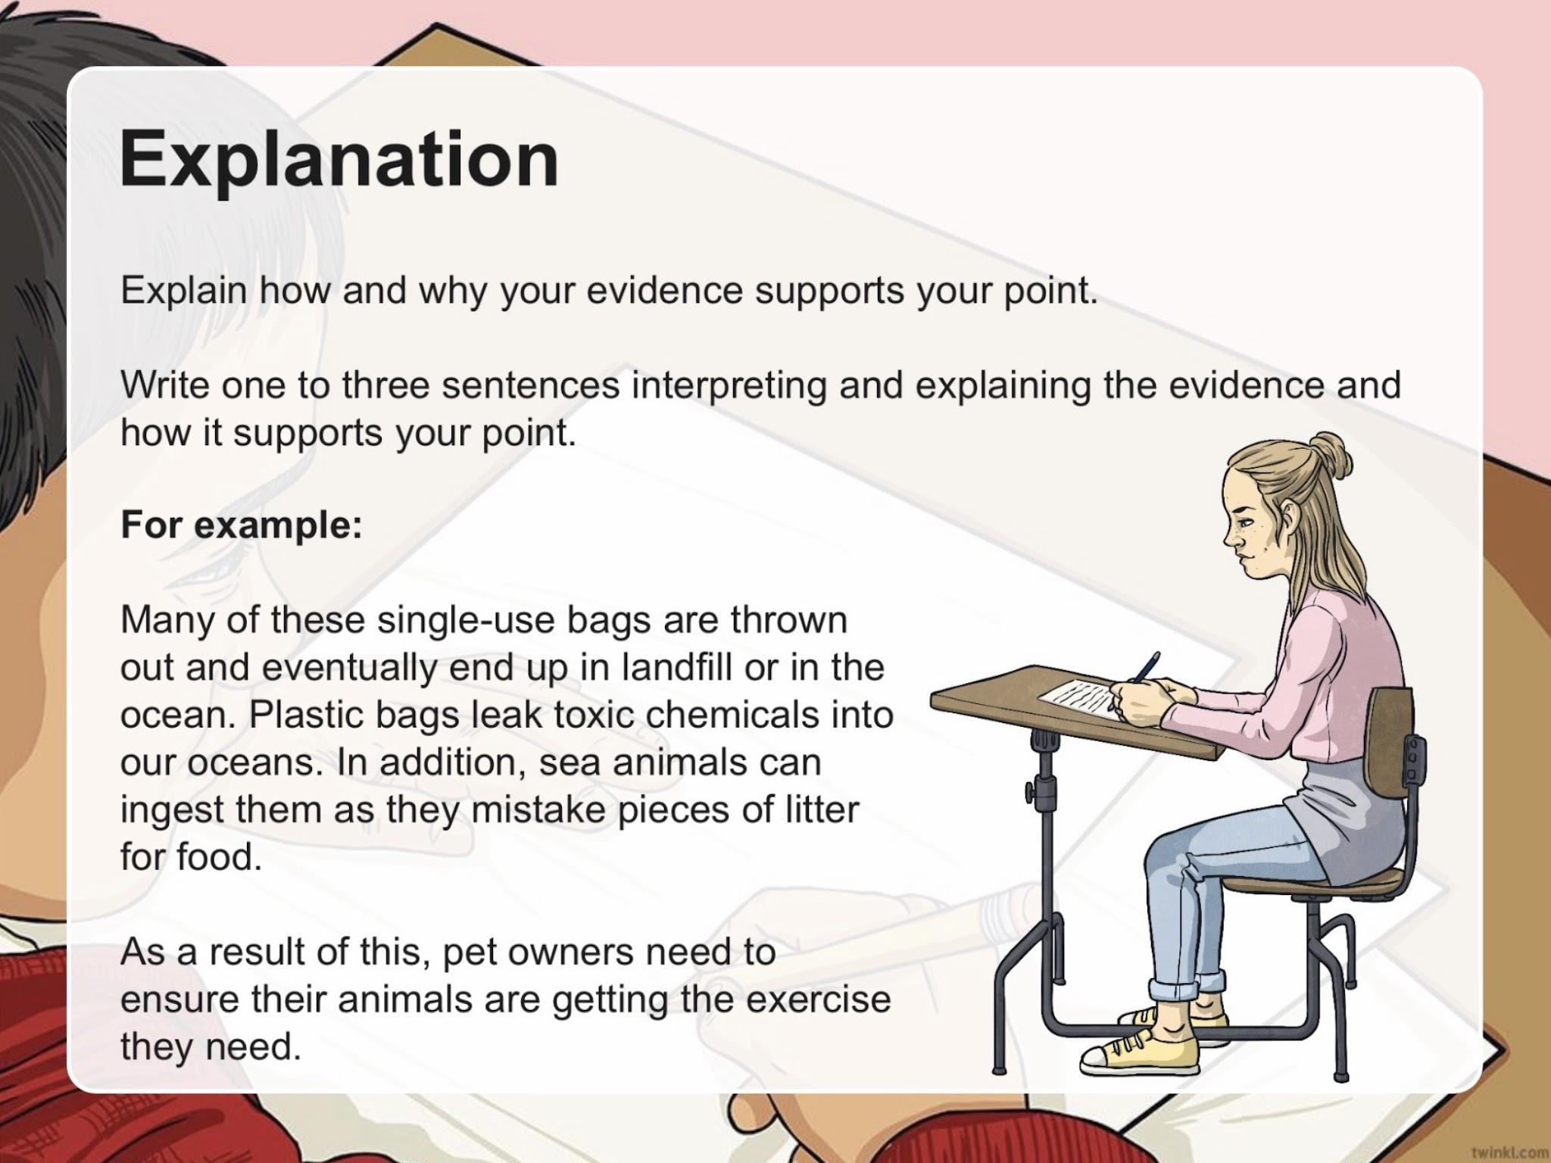

Slide 8
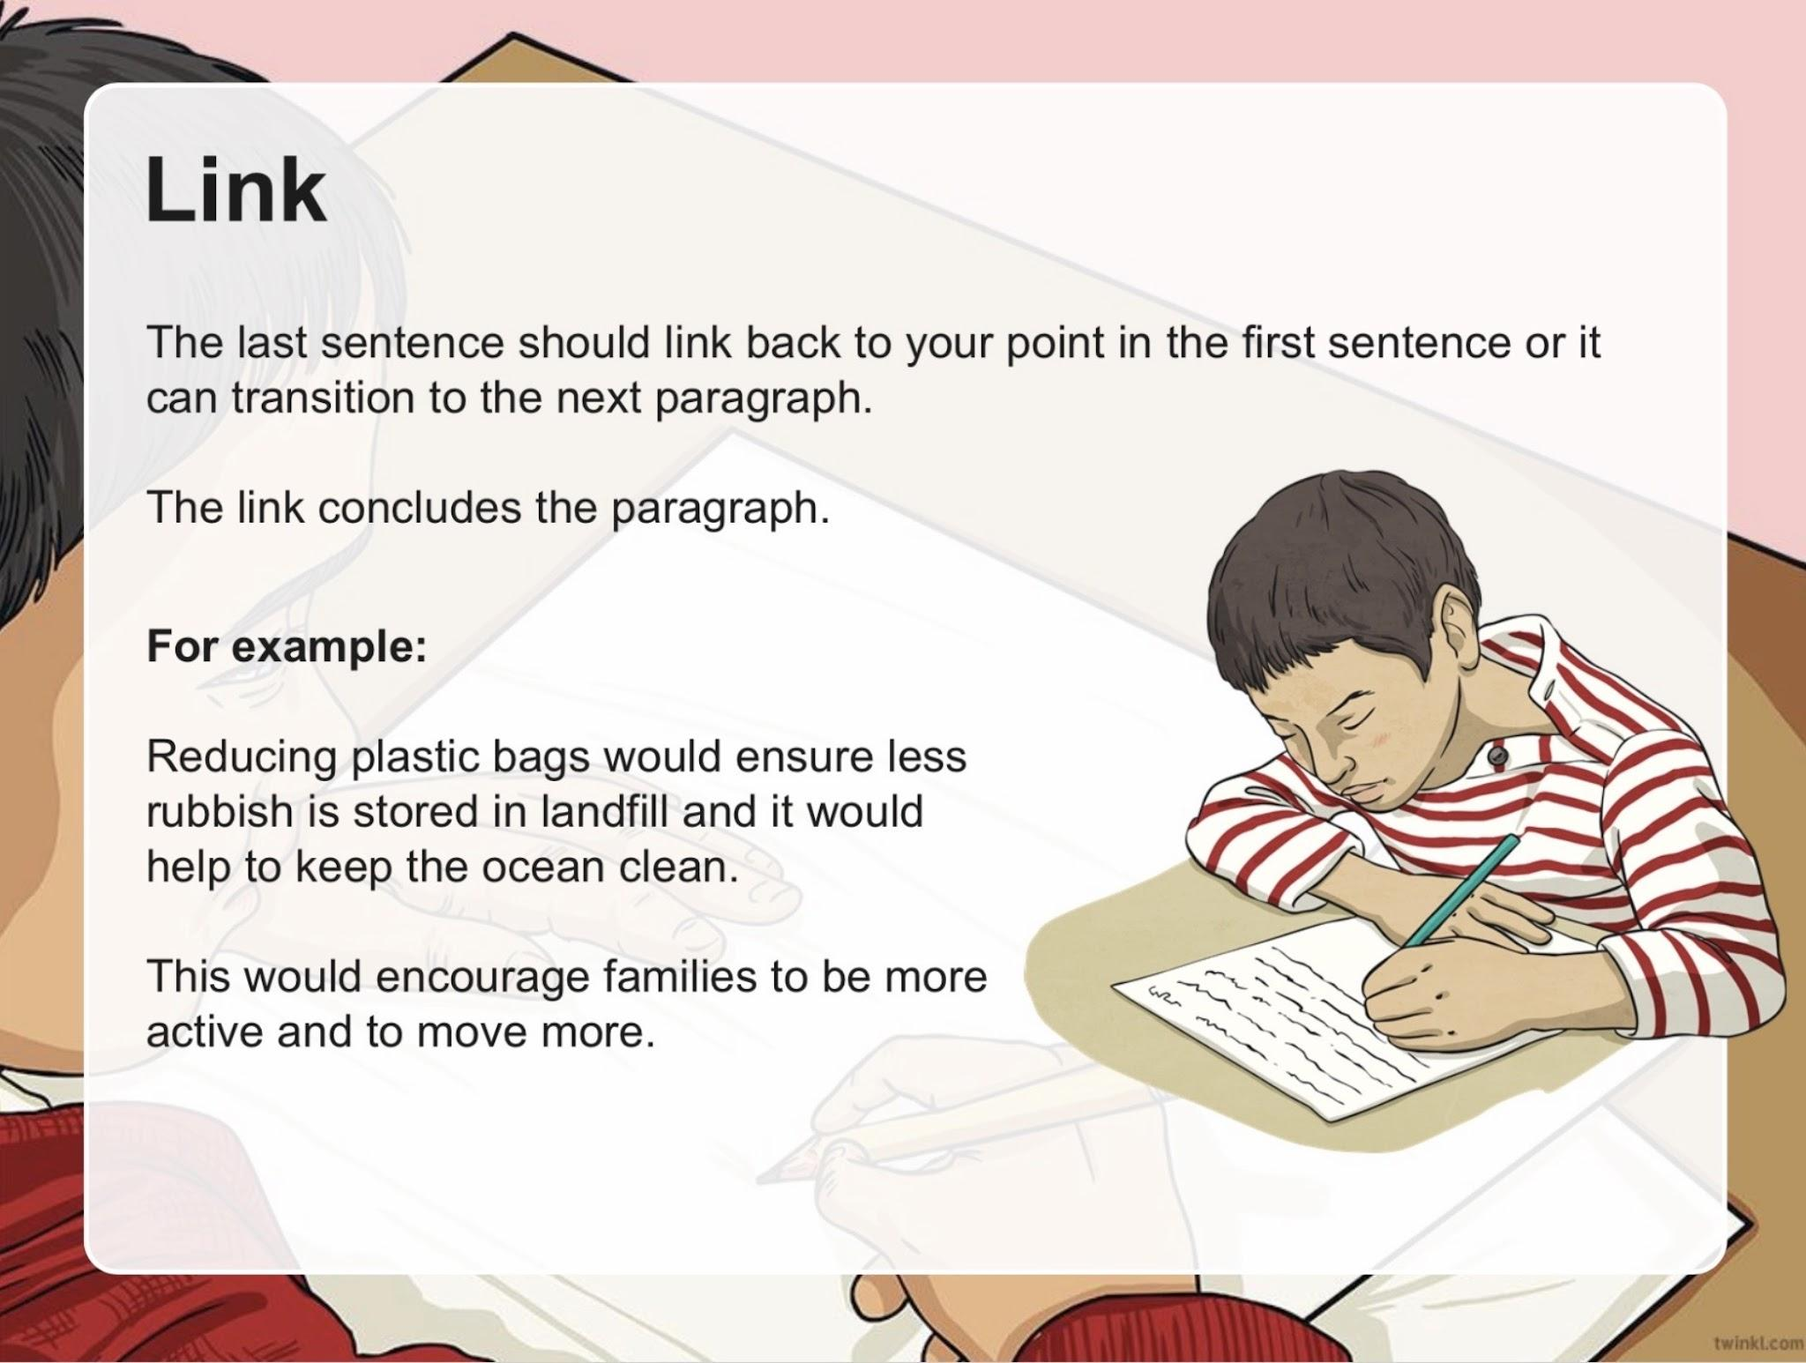

Slide 9


Slide 10
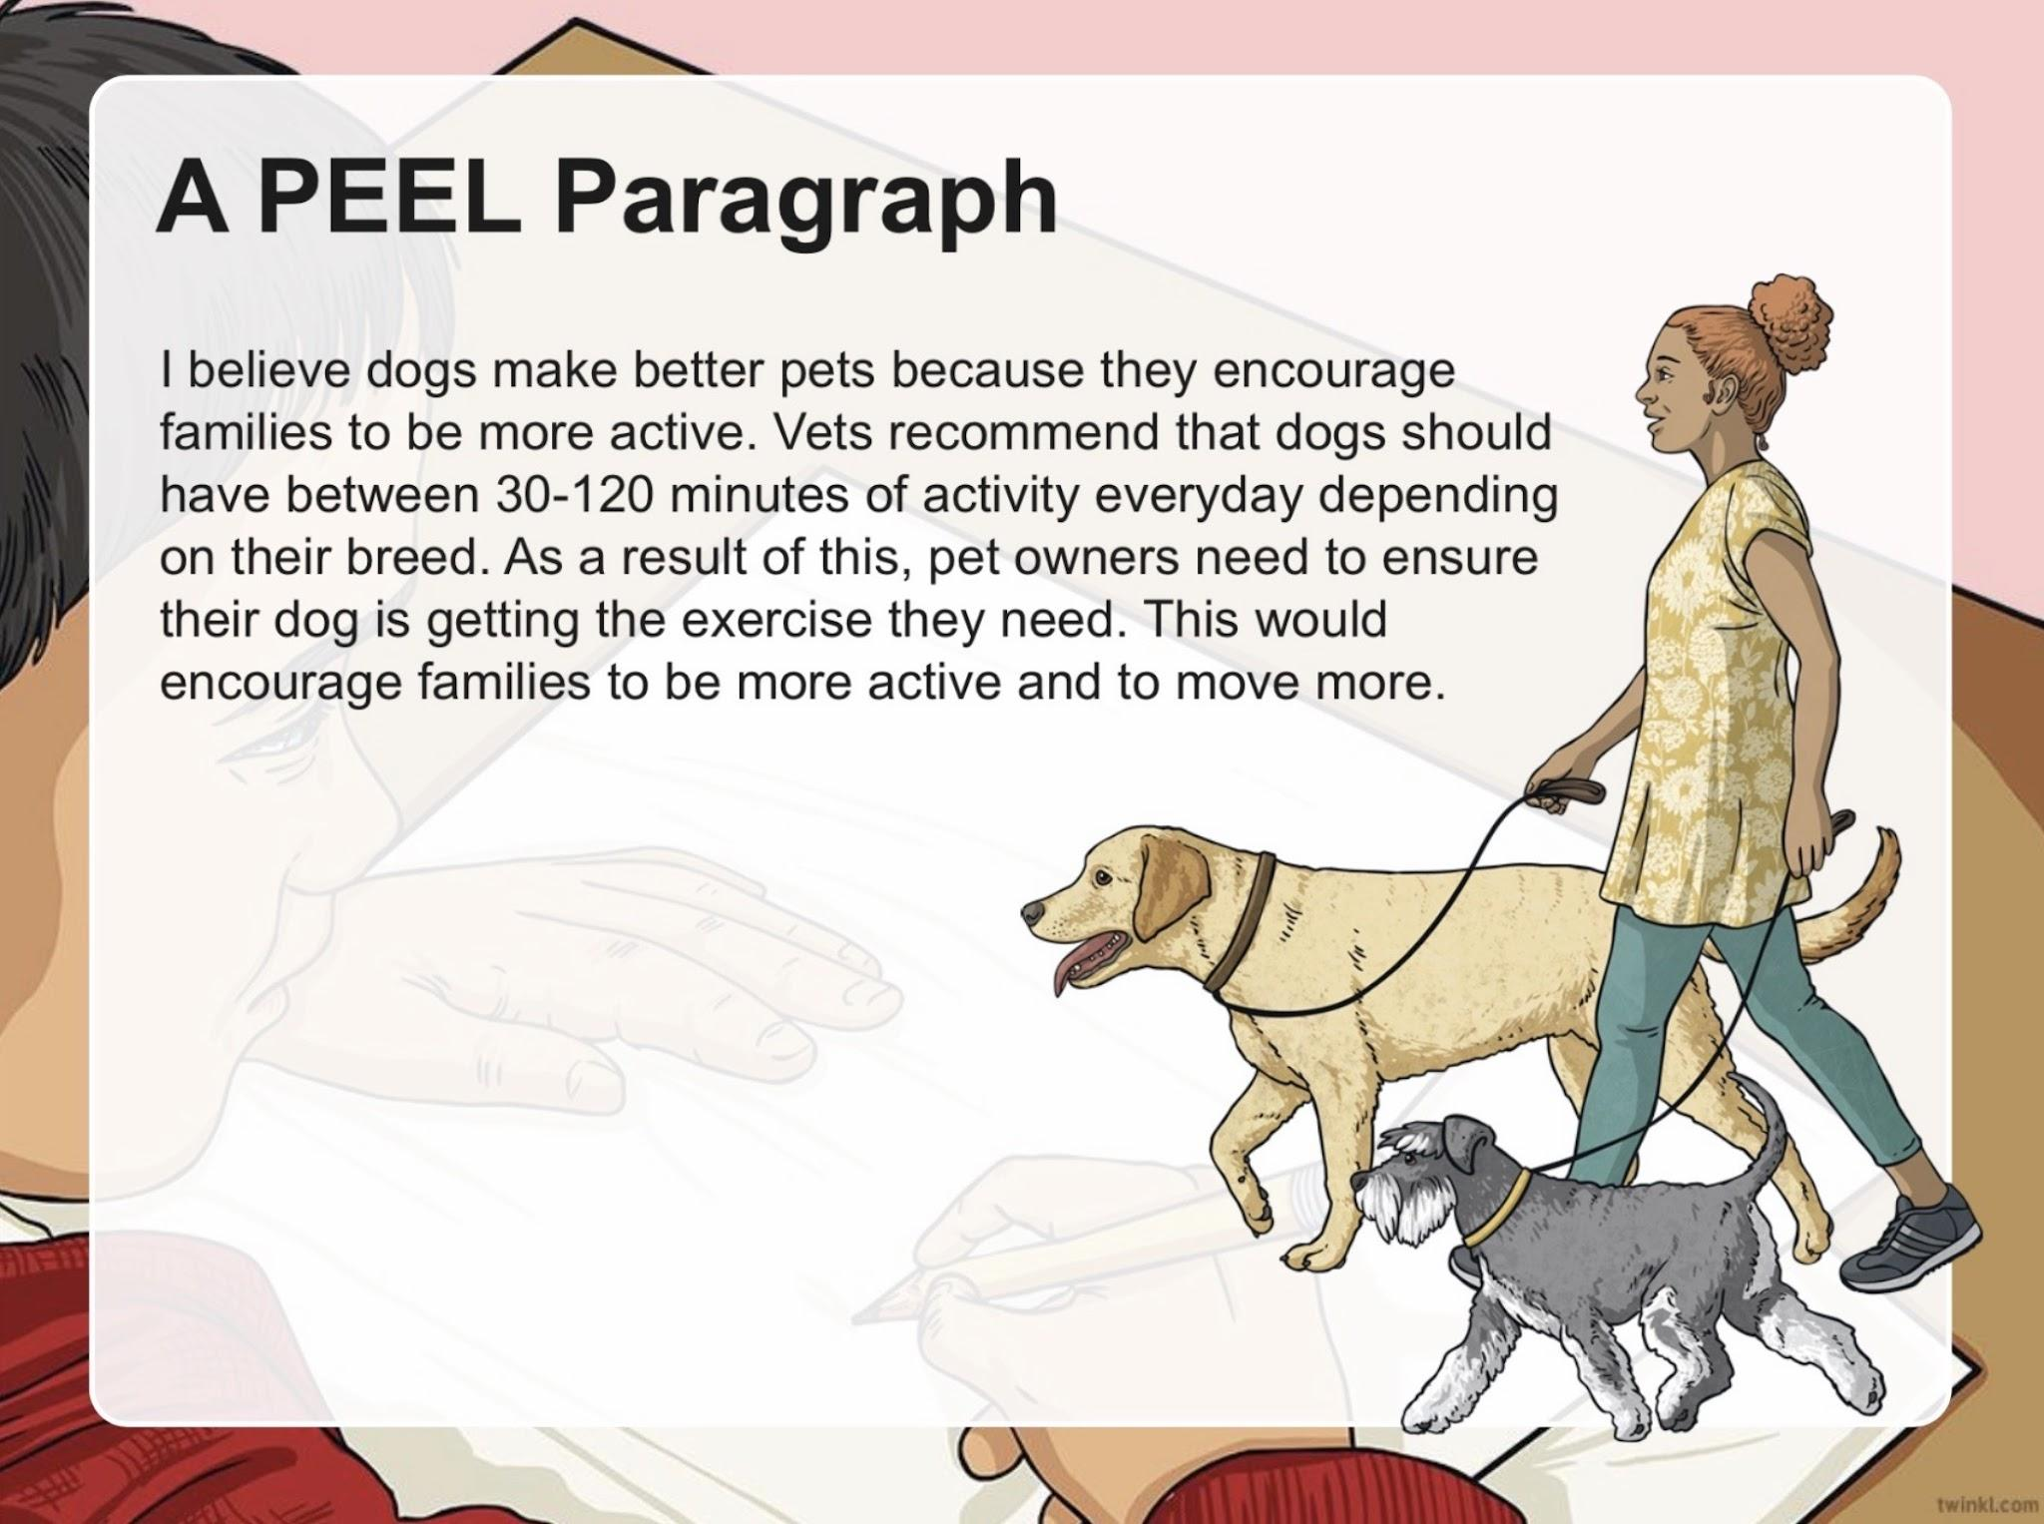

Slide 11
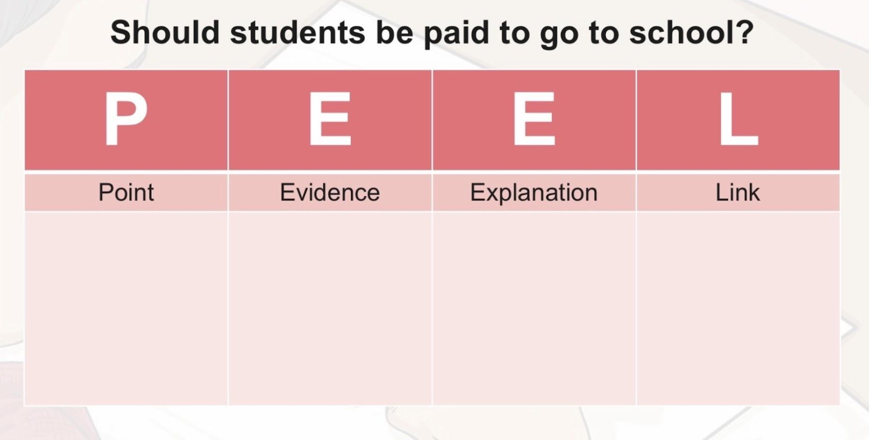
Make notes for a paragraph to answer this question. Use the notes to write the paragraph (to be done in your journals; word limit 120-150).

Slide 12
Sample answers - Viewpoint 1: Students should NOT be paid
Point:Students should not be paid to go to school because education is a responsibility, not a job.
Evidence: School already provides important benefits such as knowledge, qualifications, and skills that help students succeed in the future.
Explain: For example, students who work hard in school gain skills like problem-solving and communication, which are essential for future careers. Paying students could reduce their motivation to learn, as they may focus more on earning money than understanding their subjects. It could also create unfair pressure on students who struggle with attendance.
Link: Therefore, students should attend school to prepare for their future, not to receive payment.

Slide 13
Sample answers - Viewpoint 2: Students SHOULD be paid
Point: Students should be paid to go to school because it would encourage better attendance and motivation.
Evidence: Many students struggle to stay engaged in school, especially when they face financial difficulties at home.
Explain: Paying students could act as an incentive, encouraging them to attend classes regularly and put more effort into their learning. For example, students who receive payment may feel more motivated to complete assignments and behave responsibly in class. This could also help reduce dropout rates.
Link: Therefore, paying students to attend school could improve motivation and help more students stay in education.

Slide 14


THANK YOU

